Slide 1
Physical Attributes & Players Drafting
NFL Combine Data Case Study
Yishu Dai
October 2021
Notes:
Good afternoon, everyone. Fitness and sports are my passion, so this project inspected an NFL combined dataset, explored the different patterns of football players, and hopefully, this can be helpful for future drafting.

Slide 2
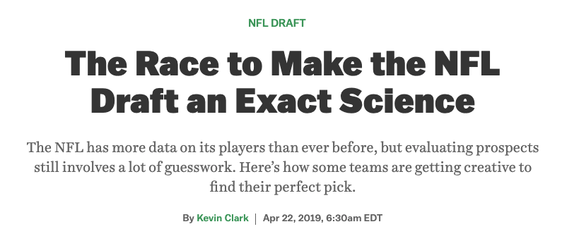
Opportunity
Data has been increasingly widely used in NFL, coaches and managers are using data to draft and trade players.
Dallas Cowboys started using data to draft players since early 1960s. Their highly unusual pick of wide receiver Bobby Hayes, who was a high-profile, track-and-field Olympic athlete, had a spectacular football career that eventually landed him in the Hall of Fame.
That said, athletes‘ physical attributes can be critical considerations when drafting players.
Notes:
Data analytics has been a popular topic in NFL for a relatively long time.
…..
Now, more and more teams have joined the competition of making the draft an exact science.

Slide 3
TABLE OF CONTENTS
01
02
03
Introduction
Methodology
Results
04
05
06
Applications
Future Work
Appendix
Notes:
The following presentation will include six parts, introduction, methodology, results, applications, future works, and appendix.

Slide 4
Introduction
Clients:
NFL team managers and coaches
Hypothesis:
- Different position players have specific physical figures.
- Players‘ best-suited positions can be determined according to drafting tests scores.
Notes:
This project expects to give NFL team managers and coaches a reason to engage data analytics during the drafting process. The project hypothesizes that, first, different position players have specific physical figures. For example, the most crucial player, the Quarterback, either hands the ball to the running back or passes the ball to a receiver, occasionally runs with the ball. So the Quarterbacks always have a medium height and weight. They need to be tall enough to pass the ball over the defenders, but they cannot be so big that they cannot dodge the tackles. For the defensive side, linebackers are pretty tall, but they are not the heaviest because they need to be solid and fast to shadow RBs, TEs, and sometimes WRs; rush the passer and tackle ball carriers.
The second hypothesis is that players' best-suited positions are not necessarily the position they started with; they can be determined according to the draft tests scores.

Slide 5
Methodology
Data: An NFL dataset that includes play-by-play data from the 2004 to 2019 seasons, and players’ physical data like heights, weight, shuttle time, bench press repetitions etc.
Tools: Excel, Python, Tableau
Notes:
This project inspected an NFL dataset that includes play data and players' information to prove that different position players have specific physical figures. Further, the project explored the possibility of determining players' best-suited positions according to drafting tests scores.
The tools used for this project are mainly Excel and Tableau. Because the dataset includes millions of data points, Python was also used for aggregation.

Slide 6
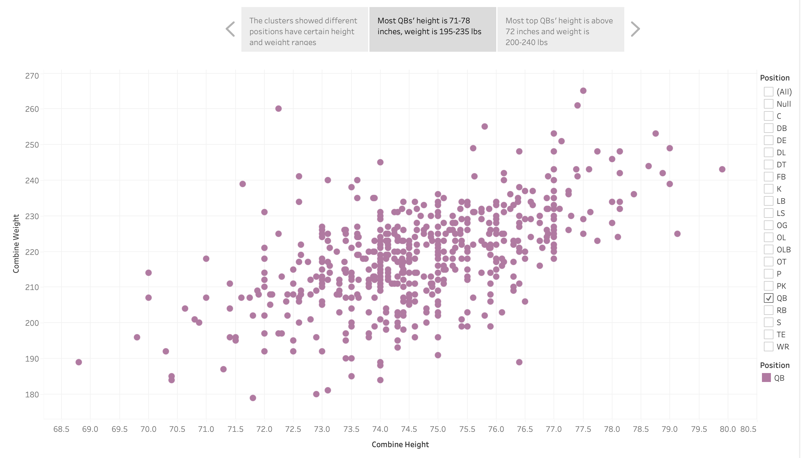
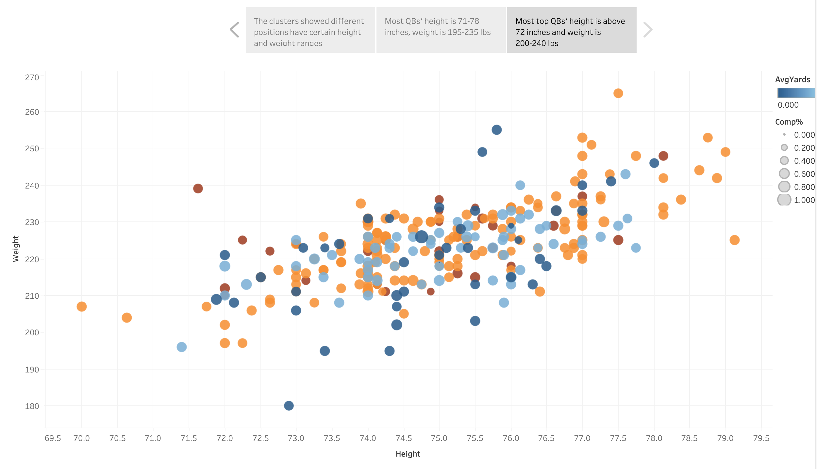
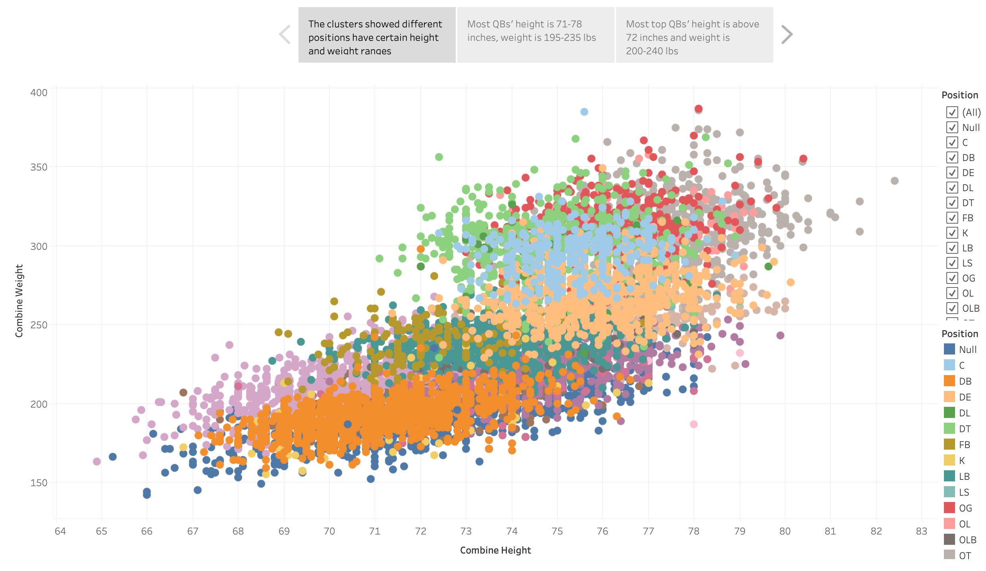
Notes:
Let us take Quarterback as an example of the solution path. For the first step, we checked the height and weight distributions for all positions. All positions have their clusters. Next, let us change the filter to only QB. The purple scatters plots showed all the QBs in the dataset. Finally, let us check the distribution by their match performance. According to the indicators, most top QBs are above 72 inches and weigh between 200 and 240lbs.

Slide 7
Results
Quarterback
Height: Above 72 inches
Weight: 200-240 lbs
Defensive Tackle
Height: 72-78 inches
Weight: 270-350 lbs
Wide Receiver
Height: 69 – 77 inches
Weight: 180 -230 lbs
Defensive Back
Height: 68-75 inches
Weight: 160-220 lbs
Running Back
Height: 67-77 inches
Weight: 190-235 lbs
Notes:
Using the same method, we got the result for all positions. Here is the summary of five relatively important positions.

Slide 8
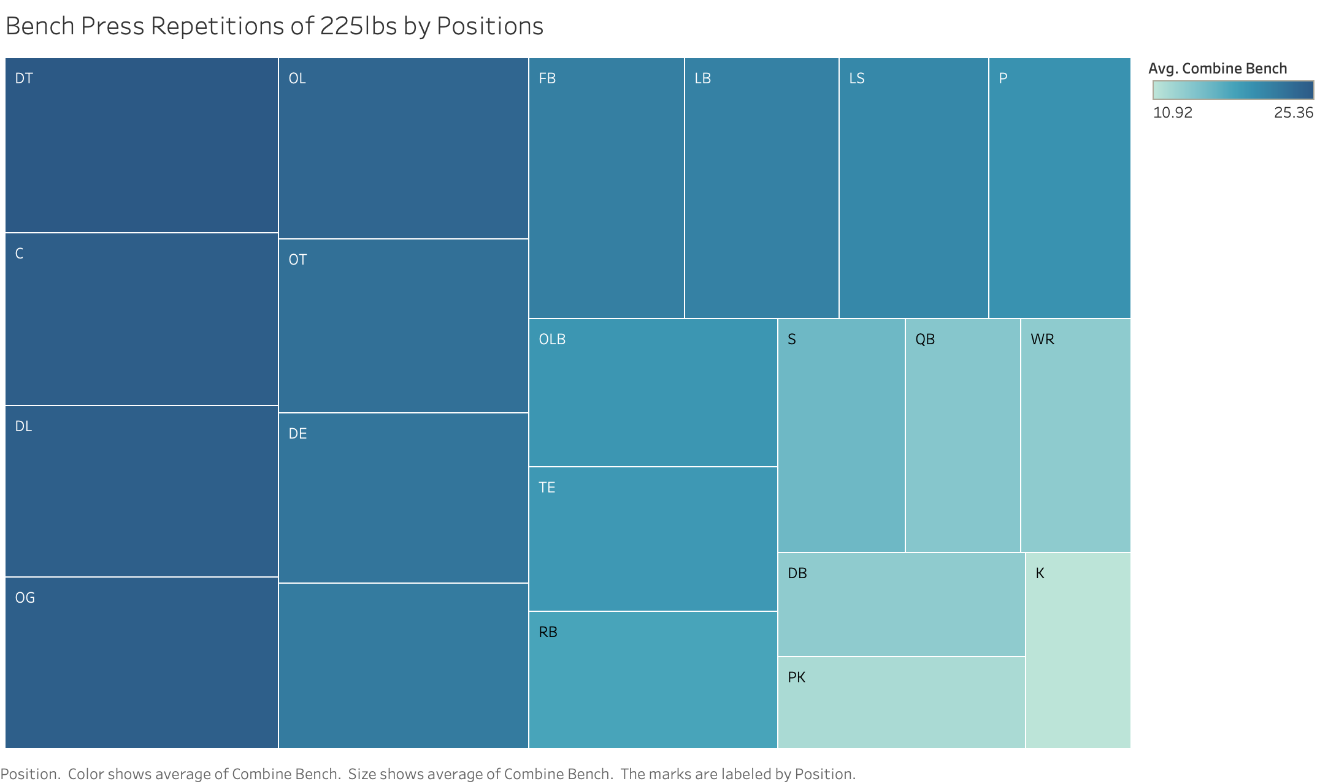
Bench Press Repetitions of 225lbs by Positions
Defensive Tackle
01
Average: 25.36
Center
02
Average: 24.90
Defensive Line
03
Average: 24.80
Notes:
Height and weight do not mean everything. So we further inspected the drafting testing scores. Defensive tackle, center, and defensive line topped the bench press repetitions of 225lbs, respectively averaged at 25.36, 24.90, and 24.80 reps.

Slide 9
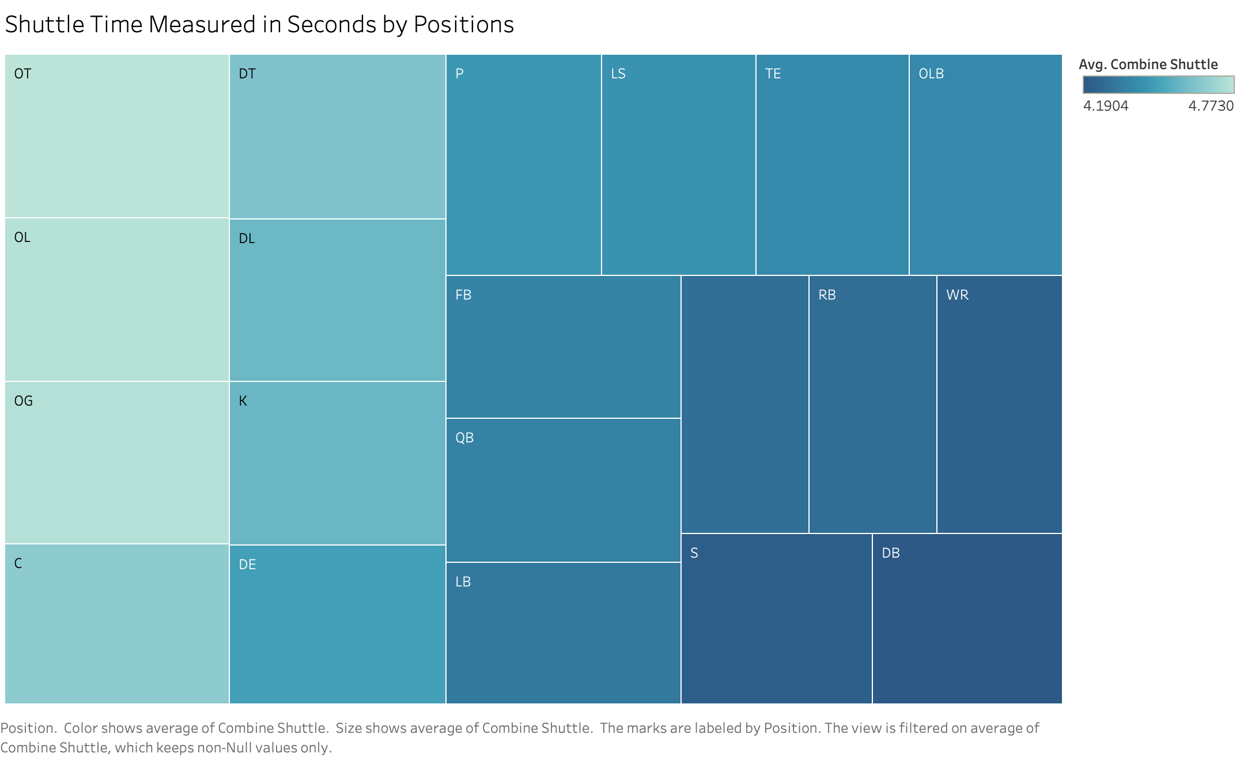
Shuttle Time by Positions (Seconds)
Defensive Back
01
Average: 4.19
Safety
02
Average: 4.21
Wide Receiver
03
Average: 4.22
Notes:
Using the same method, we identified the top scorers for other tests. Defensive back, safety, wide receiver have the shortest shuttle time averagely.

Slide 10
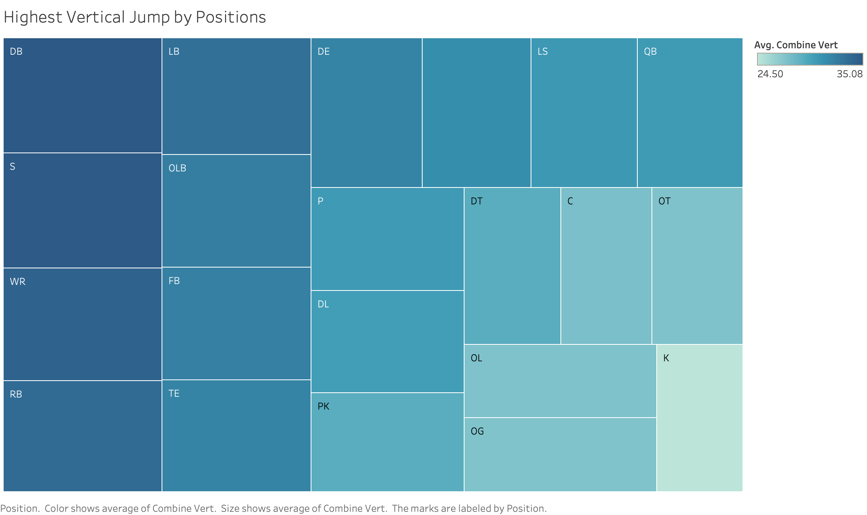
Highest Vertical Jump by Positions (Inches)
Defensive Back
01
Average: 35.08
Safety
02
Average: 35.05
Wide Receiver
03
Average: 34.38
Notes:
Not much of a surprise; the three positions also have the highest vertical jumps. They all need to be fast and robust, tackle and break a tackle, jump to catch the ball or intercept it.

Slide 11
Applications
Draft Talents
Identify Versatile Players
Generic body types and physical strengths can help the coaches discover potential talents
Players’ physical advantages can be fully utilized, and they can be trained for multiple positions. (Taysom Hill)
Notes:
Even those are only preliminary conclusions at this stage; they can be used to find generic body types and physical strengths to help the coaches discover potential talents. Furthermore, they can also be used to make the best use of players' advantages, foster more versatile players like Taysom Hill from the Saints, who is a quarterback and a tight end. His versatility made him a valuable asset. Now let us hope he gets better from last week's concussion.

Slide 12
Future Works
Build Models
More Applications
Build more precise regression models for different positions
Get more detailed stats like muscles mass and myodynamia to better identify players’ physical strength distribution
Use training data to adjust training plans
Notes:
Regression models are necessary to predict an athlete's potential more precisely. Also, it would be nice to see coaches utilizing more detailed stats like muscle mass, myodynamia, and training data to make better training plans and positions adjustments.

Slide 13
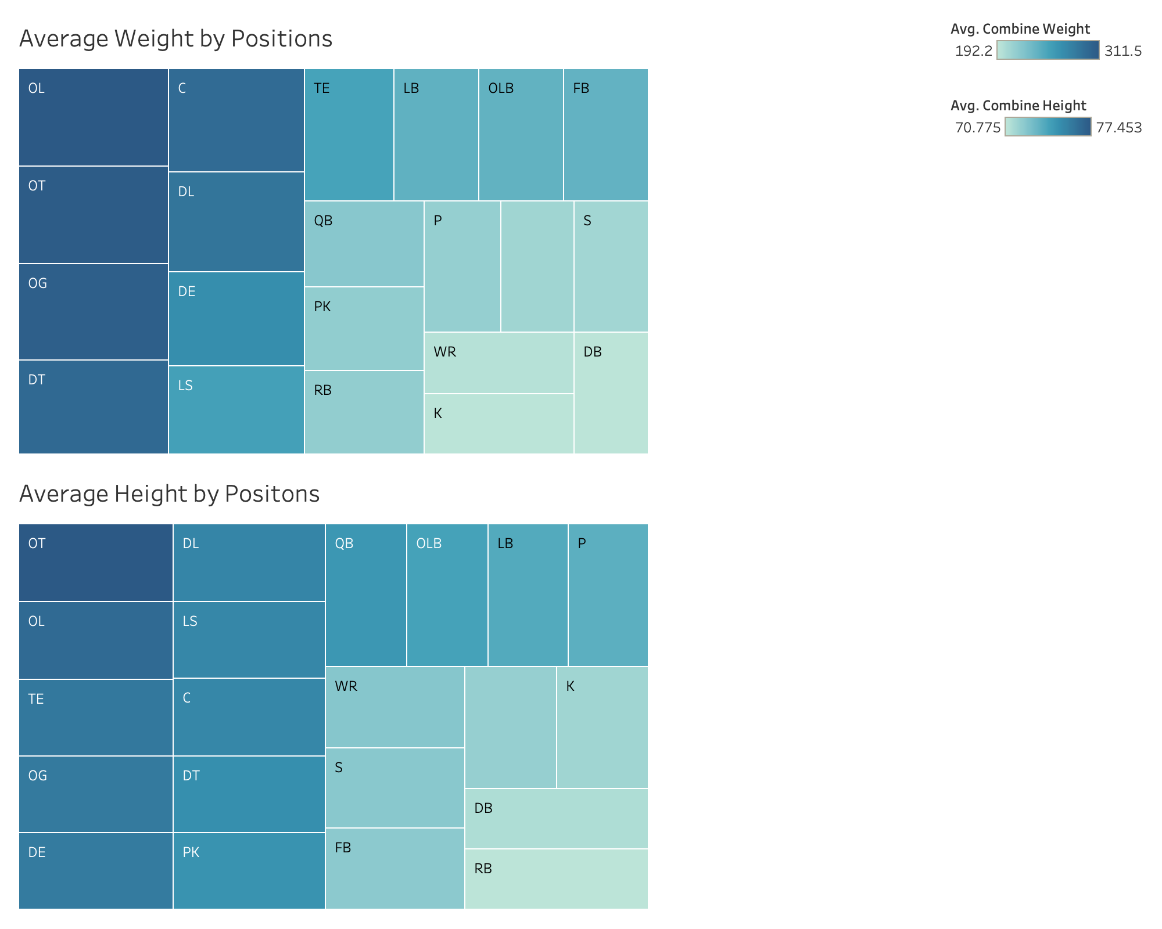
Appendix 1
Notes:
The appendix part included some visualizations that helped.

Slide 14
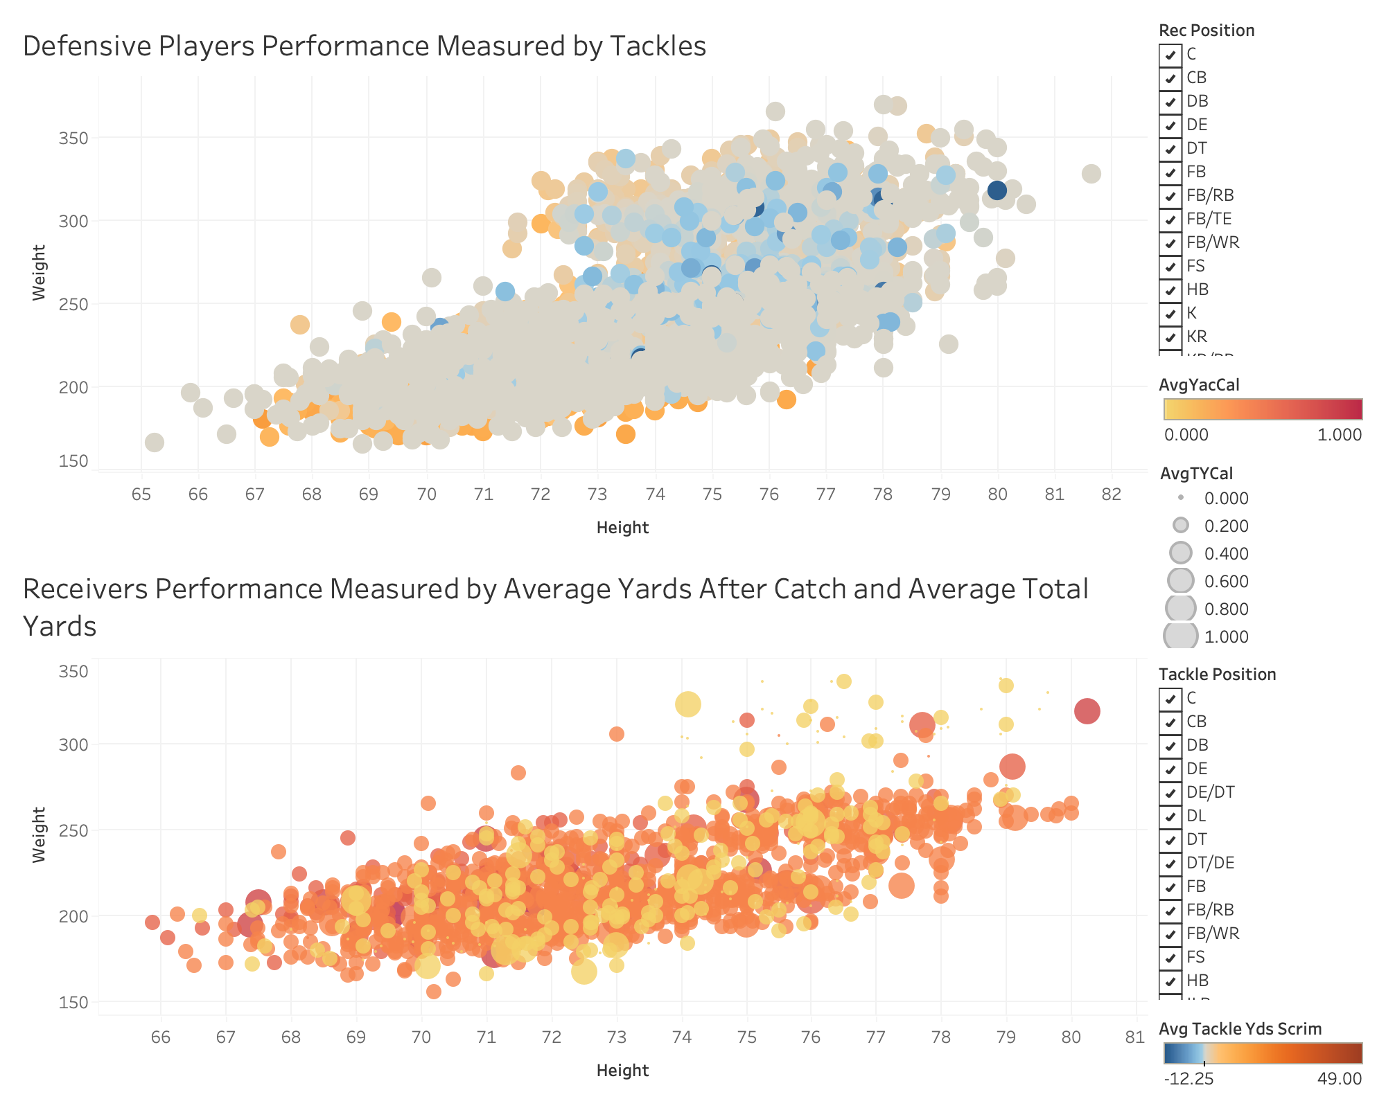
Appendix 2

Slide 15
Questions

Slide 16
THANKS!

